Slide 1

On LLM Acceleration via Memory Access Optimization
FlashAttention: Fast and Memory-Efficient Exact Attention
(FlexGen)High-throughput Generative Inference of Large Language Models with a Single GPU on with IO-Awareness
May, 2023
Yue Guan

Slide 2
Overview
FlashAttention
Contribution: Efficient attention for training and inference
Insight: GPU global memory v.s computation complexity trade-off
Method: Fusing, tiling, recomputation
FlexGen
Contribution: Efficient transformer decoder-only generation (LLM) inference
Insight: disk offloading
Method: Split batch, reuse weight, pipline activation disk access
Good implementation
Optimize memory access

Slide 3


Overview
FlashAttention
Contribution: Efficient attention for training and inference
Insight: GPU global memory v.s computation complexity trade-off
Method: Fusing, tiling, recomputation

Slide 4
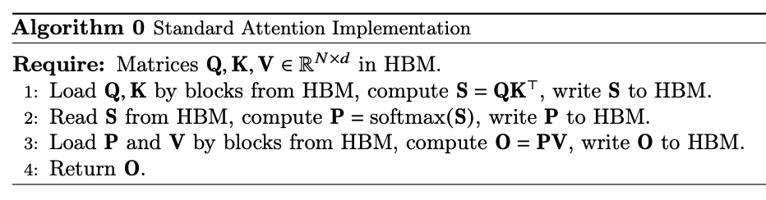
Insight
Attention calculation
Main memory access analysis
Insight
Tiling to fit shared memory access
Solve softmax tiling

Slide 5
Standard softmax in attention
Sum
20
QK
Softmax
Q
3
2
1
2
3
3
4
1
6
6
0.15
0.2
0.05
0.3
0.3
K
1
2
1
3
2
Output
V
1
2
3
4
5
0.15
0.4
0.15
1.2
1.5
3.4
Global
Shared

Slide 6
Tiled softmax
Partial Sum
3
7
8
14
20
QK
Softmax
Q
3
2
1
2
3
3
4
1
6
6
1
4/7
1/8
3/7
3/10
K
1
2
1
3
2
V
1
2
3
4
5
Output
1
11/7
7/4
19/7
3.4
Global
Shared

Slide 7
Tiled softmax
Partial Sum
3
QK
Softmax
Q
3
3
1
K
1
V
1
Output
1

Slide 8
Tiled softmax
Partial Sum
3
7
QK
Softmax
Q
3
2
4
4/7
K
1
2
V
1
2
Output
11/7

Slide 9
Tiled softmax
Partial Sum
7
8
QK
Softmax
Q
3
2
1
1
1/8
K
1
2
1
V
1
2
3
Output
7/4

Slide 10
Tiled softmax
Partial Sum
8
14
QK
Softmax
Q
3
2
1
2
6
3/7
K
1
2
1
3
V
1
2
3
4
Output
19/7

Slide 11
Tiled softmax
Partial Sum
14
20
QK
Softmax
Q
3
2
1
2
3
6
3/10
K
1
2
1
3
2
V
1
2
3
4
5
Output
3.4

Slide 12
Tiled softmax
Partial Sum
3
7
8
14
20
QK
Softmax
Q
3
2
1
2
3
3
4
1
6
6
1
4/7
1/8
3/7
3/10
K
1
2
1
3
2
V
1
2
3
4
5
Output
1
11/7
7/4
19/7
3.4

Slide 13
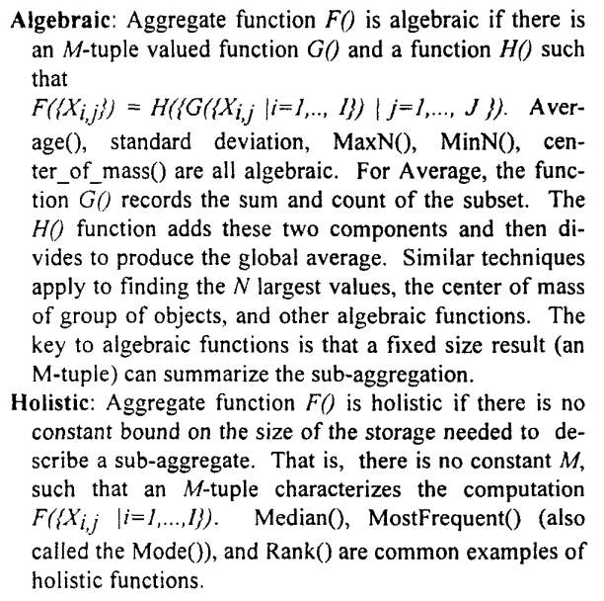
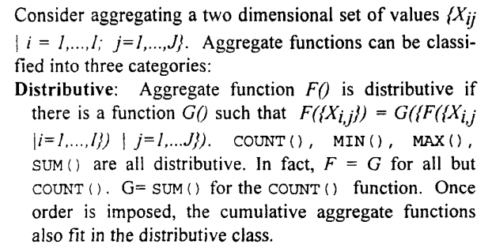
Algebraic Aggregation
Some aggregation functions can be optimized in this way:
Max, Min, Mean, Norm

Slide 14
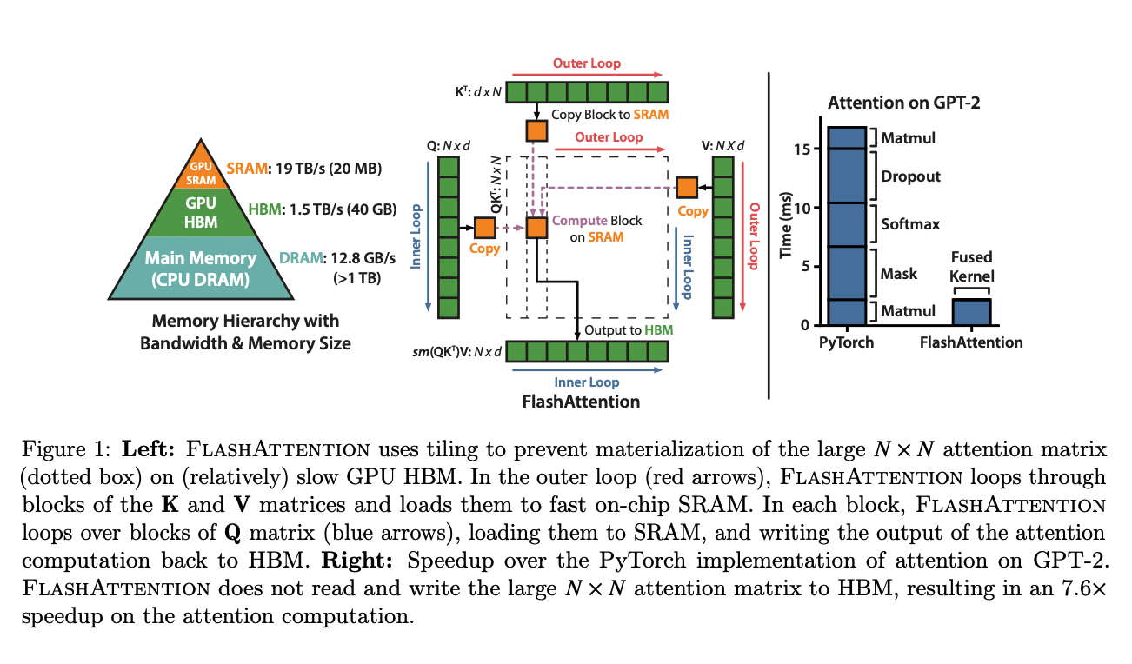
Tiled attention
With tiled softmax, the whole attention is fused as a single kernel to reduce global memory access

Slide 15
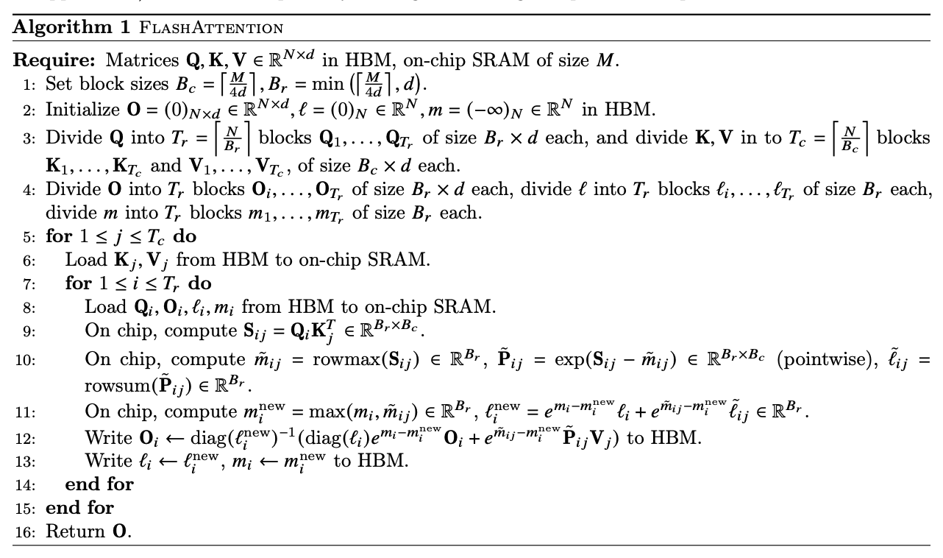
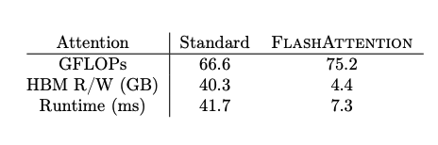
Tiled attention
Evaluation
Other optimization
Recomputation
Fusion

Slide 16
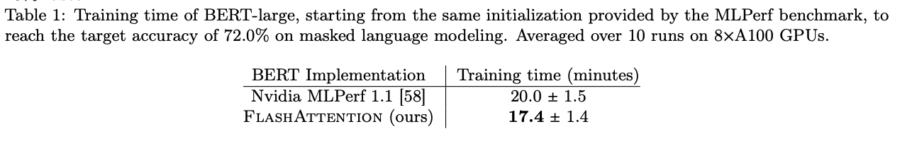
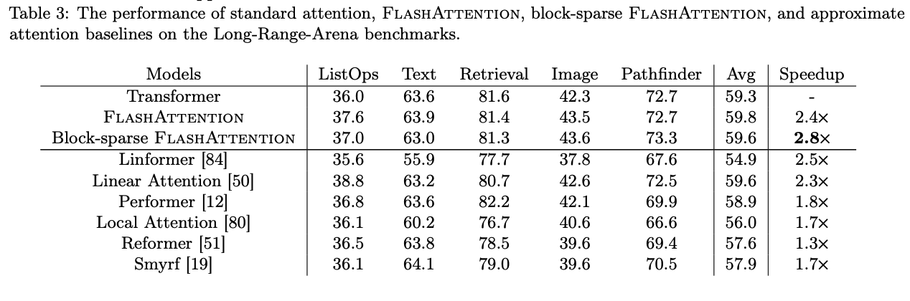
Evaluation: efficiency
Training on MLPerf
Inference on Long Range Arena

Slide 17
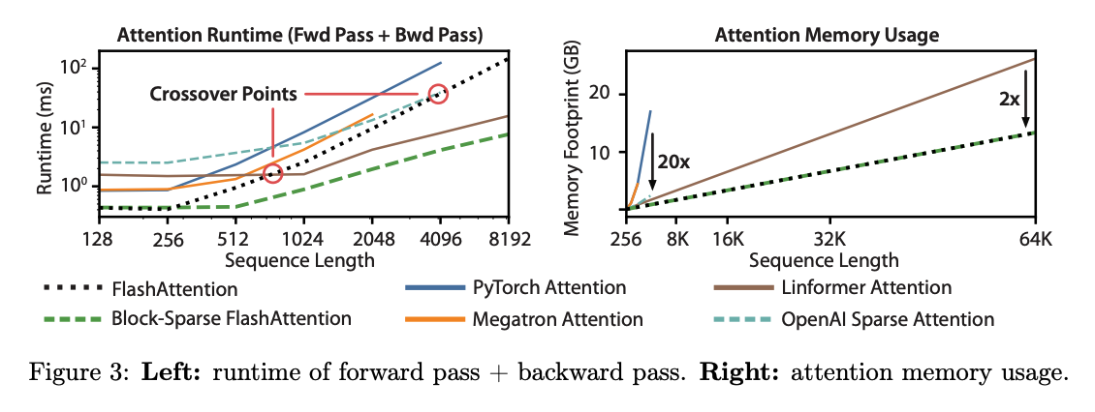
Evaluation: sparse attention

Slide 18
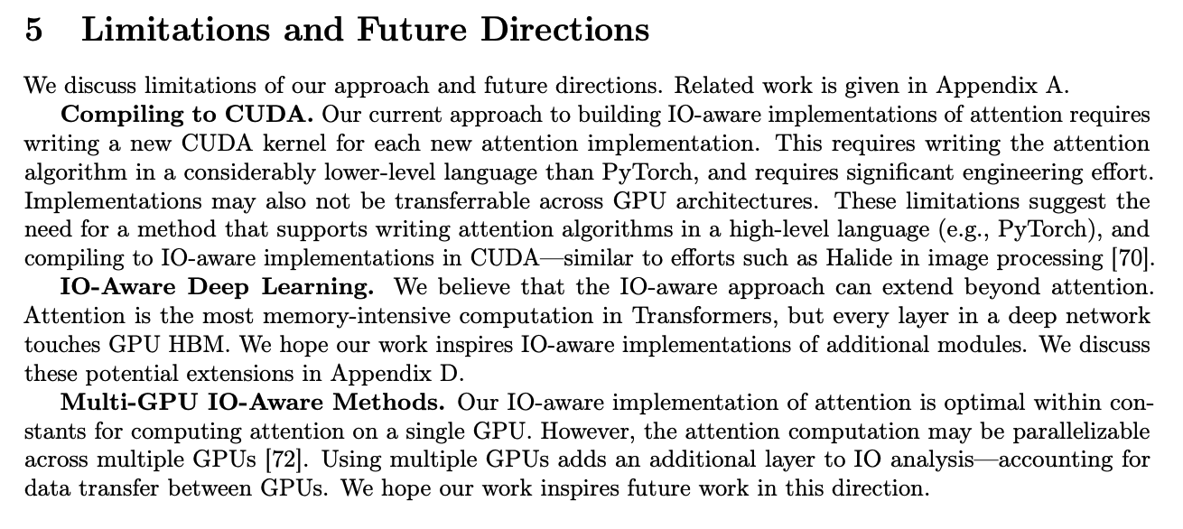
Conments
FlashAttention
Contribution: Efficient attention for training and inference
Insight: GPU global memory v.s computation complexity trade-off
Method: Fusing, tiling, recomputation

Slide 19
Overview
FlexGen
Contribution: Efficient transformer decoder-only generation inference
Insight: disk offloading
Method: Split batch, reuse weight, pipline activation disk access
Good implementation

Slide 20
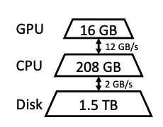
Insight
LLM inference requires massive amount of memory
GPT-175B
Weights: 325G
KV activation: 1.2T

Slide 21
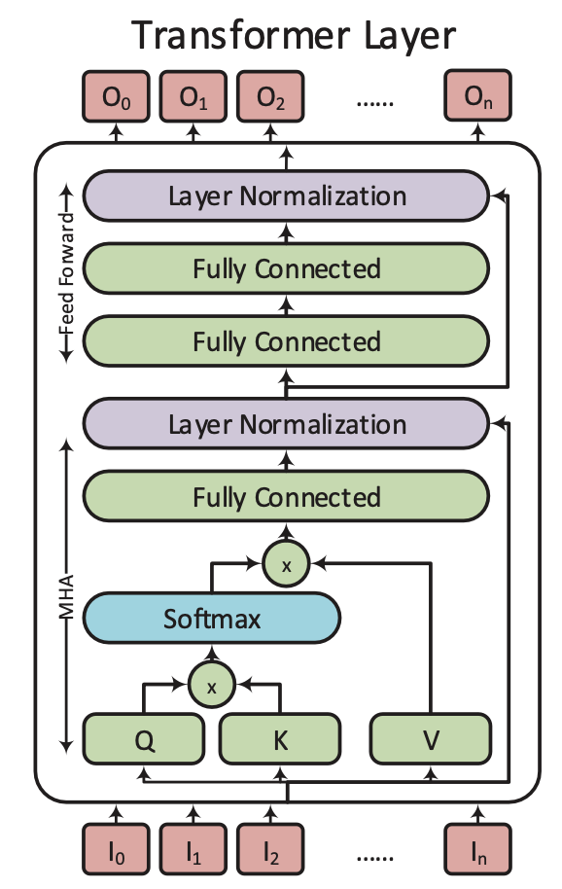

Insight
LLM inference requires massive amount of storage
GPT-175B, 512 input, 32 output
Weights: 325G
KV activation: 1.2T
KV activation is cached at low level storage

Slide 22
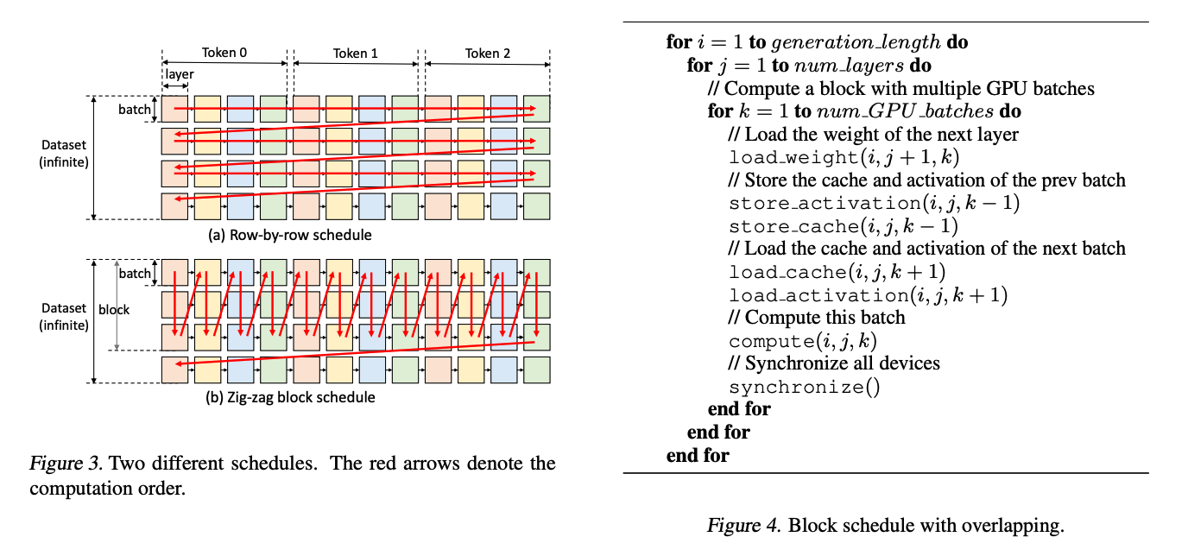
Offloading (disk access pipline)
Hide disk access with piplining
Split batch into minor-batches
Access main memory asynchronously
Overlap memory and computation

Slide 23
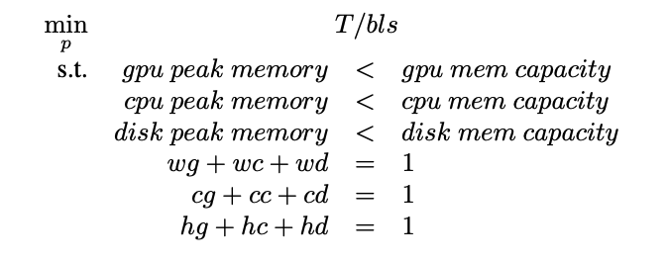
Method
Modeling the memory assignment
bls:block size
w:weight, h:activation, c:KV cache
g:GPU, c:CPU, d:DISK
Cost model T
Solve with linear programming
Multi-GPU: model parallel + FlexGen

Slide 24
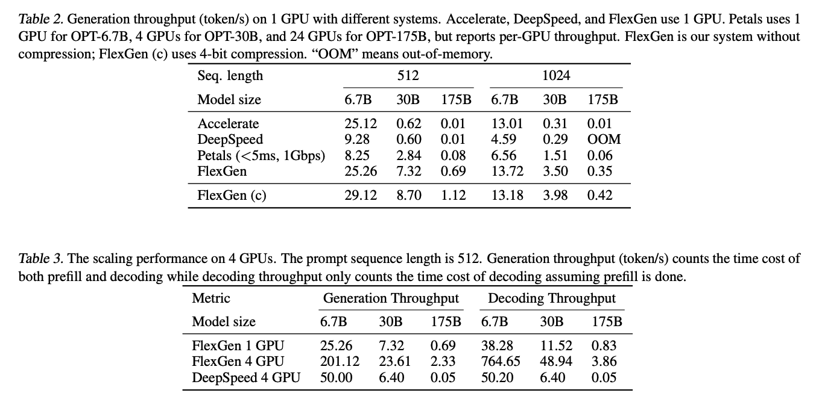
Evaluation
Throughput evaluation

Slide 25
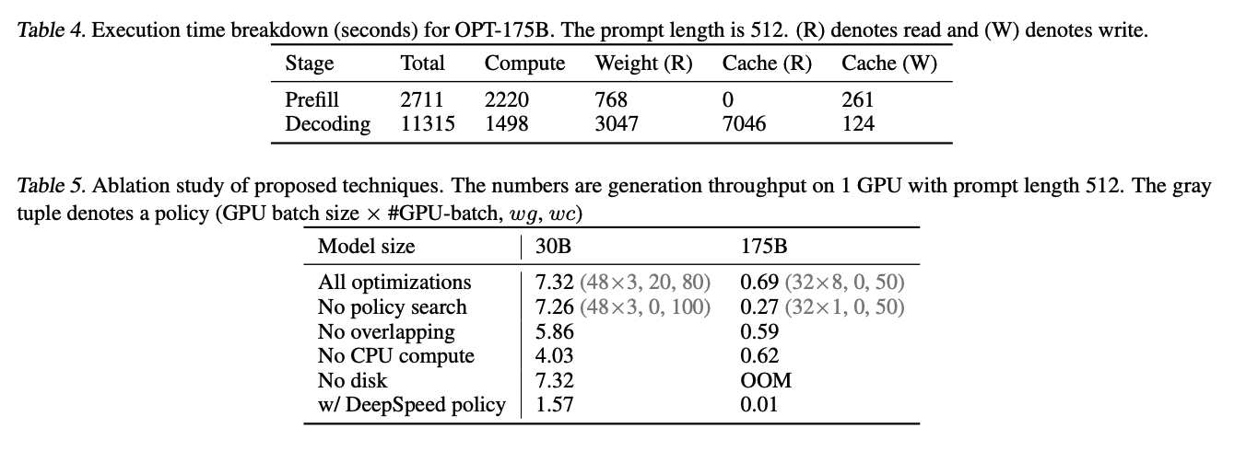
Evaluation
Weight and cache read is the bottleneck
CPU compute, overlapping is significant

Slide 26
FlexGen programming model
Wrapper level on torch
Disk: os.file
Memory: torch.cpu()
Global: torch.gpu()
Asynchronous disk-cpu: python multi-threading
Asynchronous cpu-gpu: torch.tensor.to(non_blocking=True), cuda multi-streams

Slide 27
Comments
FlexGen
Contribution: Efficient transformer decoder-only generation inference
Insight: disk offloading
Method: Split batch, reuse weight, pipline activation disk access
Good implementation

Slide 28

Conclusion
FlashAttention
Contribution: Efficient attention for training and inference
Insight: GPU global memory v.s computation complexity trade-off
Method: Fusing, tiling, recomputation
FlexGen
Contribution: Efficient transformer decoder-only generation inference
Insight: disk offloading
Method: Split batch, reuse weight, pipline activation disk access
Good implementation
Optimize memory access

